Slide 1
What is Crystal?
Alistair Cockburn
Humans and Technology
Salt Lake City, UT
arc@acm.org
http://alistair.cockburn.us

Slide 2
“Crystal is the result of Alistair’s researches.”
1991-1994 … present: ~40 interviews with project teams
  (What did you do? . . . What happened then? . . . How did you like that? . . . Would you work that way again?
  Is what (s)he said true? . . . Show me work products)
Results:
  People don’t do what their book says to do,
  nor do they do what they say they did.
  They can’t keep the documentation in sync with the code.
  The lightest methodology that works is already too heavy.
  Fiddling with it is a CSF of methodology adoption.
  “Crystal Clear” is an ultralight methodology capturing common practices of successful small teams around the world, across different technologies.

Slide 3
“Crystal is the way Alistair works.”
(Different situations, common theme)
(N.B.: methodologies look like their authors’ work habits !)
1994-95: Project Winifred - delivered on time (over budget)
  45 people: 24 Smalltalk, 4 COBOL, 2 DBAs
  Fixed-price, fixed-time, 18-mo. bid 15M$ (1994 $)
1997-98: Norges Bank project
  3 people -> 8 people linking to 35 people, distributed
  Banking: COBOL, Assembler, CICS, LU 6.2
2001: First Rand Bank (S. Africa) web presence
  50-person company, steady stream of initiatives
  2-week release cycles

Slide 4
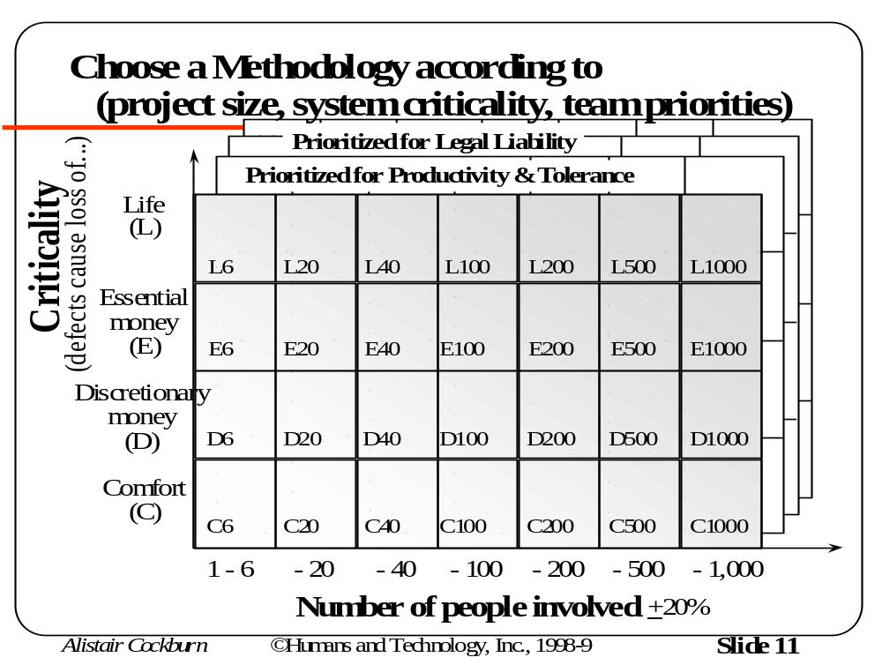
“Crystal is a family of methodologies.”
Technologies
change
techniques.
Cultures
change
norms.
Distances
change
communication.
Not even conceivable to have a single, common methodology.
Every project is slightly different and needs its own.

Slide 5
Supershort
Methodology Tutorial
Values
Quality
Activities
Teams
Teams
Products
Techniques
Roles
Standards
Tools
Skills

Slide 6
What is a methodology?
A set of rules you have to follow.
The set of conventions the group decides to follow.

Slide 7
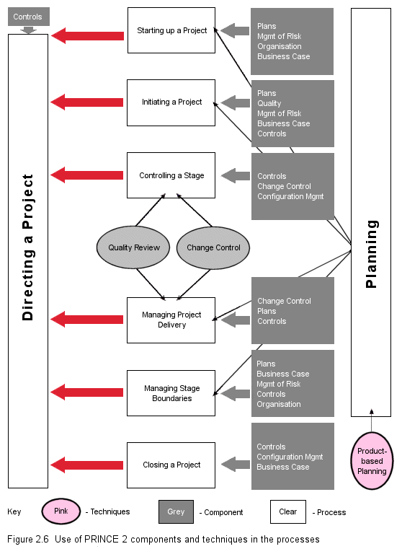
PRINCE2
Source: maxwideman.com

Slide 8
A Methodology properly discusses the Products, the Factory and the Control System
Factory
Products
Control
System
Notation
Tools
People, Organization, Culture

Slide 9
Methodology: who, what, when of interactions
Process
Milestones
Planning
Team Values
Testing
Quality
Activities
Teams
Regression tests
Project manager
MBWA
Documenter
Object model
Use cases
Project plan
Designer
CRC cards
Tester
Use cases
Products
Techniques
Roles
People
Microsoft Project
Envy/Developer
JAD facilitation
3month increments
STP
Java programming
Microsoft Project
Modeling
Personality
UML / OMT
C++
Standards
Tools
Skills

Slide 10
Methodology is organization-personal: how you produce and deliver systems
"Methodology is a social construction" - Ralph Hodgson
Methodology is how you manage to ship systems
  Who you advertise for
  How tightly requirements are gathered
  Design standards, shortcuts, deliverables
  Team size and makeup
  Languages, standards, scheduling strategy
Designing one is NOT like designing software!
  Highly variable components (people!)
  Very long cycle / debug times
  Culture and project dependent
  Standard novice errors based on the above.

Slide 11
Standard methodologist errors:
One size, intolerant, embellished, heavy, wrong.
e1. One size methodology (projects vary)
e2. Intolerant methodology (people vary)
e3. Embellished ('did do' or 'should have done'?)
e4. Heavy (more writing /= more safety)
e5. Untried (lots of errors)
e6. Tried once (limited applicability)
(e 3-6 also apply to expert methodologists!)
"Embellishment is the pitfall of the methodologist"

Slide 12
Who can use a defined methodology?
Any group of people
Only experts
A team with a minimum number of experts
  (How many experts?)
  (What ratio to novices?)

Slide 13
What is expertise?
(the Shu-Ha-Ri progression)
Level 1
  Learning “a technique that works”
  Success is following the technique (and getting a success)
Level 2
  Learning limits of the technique
  Success is shifting from one technique to another
Level 3
  Fluid mastery - shifting techniques by moment
  Unable to describe the techniques involved
The 3 levels apply to all techniques, including software design, management, & methodology adjustment !

Slide 14
End of
Supershort
Methodology Tutorial
Values
Quality
Activities
Teams
Teams
Products
Techniques
Roles
Standards
Tools
Skills

Slide 15
Finally, a sensible way to describe it:
Methodology is . . .
The conventions the team agrees to follow:
  range from clothing to coding
  change all the time
  the team chooses/rejects/affects
Requiring a certain level of prior experience to apply:
  at least one person having done something similar
  some mixture of new people and experienced
  ideally a level-3 person present to make adjustments

Slide 16
Crystal is a family of methodologies . . .
. . . Emphasizing fast, personal communications
(speed of change)
. . . Tolerating many styles of development
(well-meaning but careless people who work in many ways)
. . . With a common, key set of values
and principles
. . . Increments & reflection
only common themes
. . . No upward / downward
compatibility (fit-for-the-job)
. . . Three examples documented
(Clear, Orange, OrangeWeb)
. . . Needing one level-3 person
L6
L20
L40
L80
E6
E20
E40
E80
D6
D20
D40
D80
C6
C20
C40
C80
Clear
Yellow
Orange
Red

Slide 17
Crystal lives on three levels:
-Mindset -Principles -Specifics
Mindset: “Software development is a (resource-limited) cooperative game of invention and communication.”
  (generates & limits ideas, provides consistency)
Principles: “Lighten work products, improve fast & informal communication, deliver early & regularly”
  (guide adjusting to circumstances)
Specifics: Crystal Clear, Orange, OrangeWeb
  (provide concreteness, seed the process)
  (People work better by copying than inventing from scratch)
There is no, can be no, “formula”

Slide 18
Crystal’s
Mindset
“Software development is a
(resource-limited)
finite, goal-seeking
cooperative game
of invention and communication.”

Slide 19
Sw Development is a Game of Economics
Economic consequences to each choice.
Resources are limited.
“Less” is usually better.
“Barely sufficient” is Best !

Slide 20
Players in the game are “People” -
Highly nonlinear, spontaneous active devices
Weak points:
Consistency
Discipline
Following instructions
Strong points:
Looking around
Taking initiative
Copy /modify-ing
Communicating

Slide 21
The game has a primary and secondary goal: Two Games in One !
Primary Goal
  Deliver working software.
  (Mess up the first goal => no software.
Secondary Goal
  Set up for the next game.
  Mess up the secondary goal => disadvantaged next project

Slide 22

Crystal’s
Principles
2 people at
whiteboard
2 people
on phone
Communication Effectiveness
(Question-and-Answer)
Videotape
2 people
on email
Audiotape
Paper
(No Question-Answer)
Richness (“temperature”) of communication channel
“cold” “hot”

Slide 23

Agile methodologies emphasize
“manoeverable, responsive to change”
Agile Software Development Manifesto: We value
  Individuals and interactions over Processes and Tools.
  Working software over Comprehensive documentation.
  Customer collaboration over Contract negotiation.
  Responding to change over Following a plan.
(©2001, Kent Beck, Mike Beedle, Arie van Bennekum, Alistair Cockburn, Ward Cunningham, Martin Fowler, James Grenning, Jim Highsmith, Andrew Hunt, Ron Jeffries, Jon Kern, Brian Marick, Robert C. Martin, Stephen J. Mellor, Ken Schwaber, Jeff Sutherland, Dave Thomas )
All very nice, but how do you do it?

Slide 24
Seven principles
1. Face-to-face
  Interactive face-to-face communication is the cheapest and fastest channel for exchanging information
2. Weight is costly
3. Heavier methodologies for larger teams
4. More ceremony for more criticality
5. More feedback & communications, fewer intermediate deliverables
6. Discipline, skills, understanding counter
process, formality, documentation
7. Efficiency is expendable at non-bottleneck activities.

Slide 25
Principle 1:
People communicate best interactively face-to-face.
(but not for legal traceability!)
2 people at
whiteboard
2 people
on phone
Communication Effectiveness
Videotape
(Question-and-Answer)
2 people
on email
Audiotape
Paper
(No Question-Answer)
Richness (“temperature”) of communication channel
“cold” “hot”

Slide 26
Seven principles
1. Face-to-face
  Interactive face-to-face communication is the cheapest and fastest channel for exchanging information
2. Weight is costly
3. Heavier methodologies for larger teams
4. More ceremony for more criticality
5. More feedback & communications, fewer intermediate deliverables
6. Discipline, skills, understanding counter
process, formality, documentation
7. Efficiency is expendable at non-bottleneck activities.

Slide 27
Adding people is expensive.
(Methodology grows with number of roles.)
Communications Load
(Methodology Cost)
Effectiveness
per person
Number of people

Slide 28
Methodology weight is costly
Larger teams need more … diminishing returns
large team
Problem Size
small team
Methodology Weight

Slide 29
Lighter methodologies are better, but have limits
Heavy
Number of People Needed
Medium
Light
Problem Size

Slide 30
Different methodologies are possible & needed
(project size, system criticality, priorities, fears)
. . .
Prioritized for Legal Liability
Prioritized for Productivity & Tolerance
Life
(L)
Criticality
(defects cause loss of...)
L6
L20
L40
L100
L200
L500
L1000
Essential
money
(E)
E6
E20
E40
E100
E200
E500
E1000
Discretionary
money
(D)
D6
D20
D40
D100
D200
D500
D1000
Comfort
(C)
C6
C20
C40
C100
C200
C500
C1000
1 - 6
- 20
- 40
- 100
- 200
- 500
- 1,000
Number of people involved
+20%

Slide 31
The “correct” mix of planning vs. reacting depends on the individual project’s risk exposure.
Plan-driven
sweet spot
Damage from
over/underplanning
Agile
sweet spot
Time and Effort Invested in Plans
from “Get Ready for Agile Methods – With Care”
(Barry Boehm, IEEE Computer, January 2001)

Slide 32
Seven principles
1. Face-to-face
  Interactive face-to-face communication is the cheapest and fastest channel for exchanging information
2. Weight is costly
3. Heavier methodologies for larger teams
4. More ceremony for more criticality
5. More feedback & communications, fewer intermediate deliverables
6. Discipline, skills, understanding counter
process, formality, documentation
7. Efficiency is expendable at non-bottleneck activities.

Slide 33
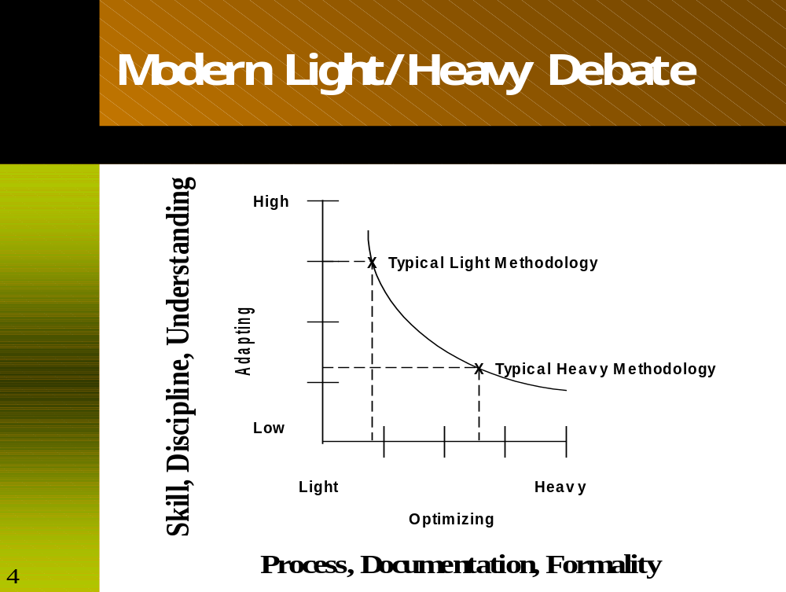
Jim Highsmith: Skill, discipline, understanding vs. process, documentation, formality
(Agile methods draw more on
team’s “tacit” knowledge.)

Slide 34
Principle 7: Efficiency is expendable away from bottleneck activities (1).
Requirements
Completeness, Stability
UI design &
Object Design
Programming
Testing
Requirements
Serial
Development
Design
Program
Test
Requirements
Concurrent
Development
Design
Program
Test

Slide 35
Principle 7: Efficiency is expendable away from bottleneck activities (2).
Requirements
Designer/
Programmer
Designer/
Programmer
Designer/Programmer
Completeness, Stability
Designer/
Programmer
DBA
Designer/
Programmer
DBA
Designer/
Programmer
Time

Slide 36
Warning: Methodology is cultural engineering!
A methodology is a micro-culture embedded in two outer cultures.
  Company culture
  National culture
  fit the outer culture?
  Rejected?
  Both will change
What sort of culture do you have?
  Hierarchy
  Chaos
  Consensus
  Synchronized Silence
Tools
Notation
People
Organization
& Culture

Slide 37
Buy-In: self-determination or crisis
Expert's buy-in
  Has mental tool box proven complete
  Needs full breakdown to create space for alternate tools
Novice's buy-in
  Has mental tool box with space and need for new tools
∴ expert may need crisis to accept new ideas.
Buy-In through self-determination:
  In methodology workshop, team members name their
  roles, teams, products, standards, milestones, tasks.
...but how do you install an 'M' across projects?

Slide 38
Starting point for Crystal: interviews, workshop, feedback
Build the control system first.
  Settle increment size,
  Hold interview & workshop before/after each.
Preload the system.
  Interview projects to learn key issues, hazards, tricks.
  Ask what they did, liked, didn't, would change or keep.
  Identify fears, priorities, success factors, hazards.
Ask the group.
  Let the group influence first increment's methodology.
Use your feedback
  Check mid- and post-increment opinion
  Update your principles, fears, strategies.

Slide 39
Crystal
Samples
&
Specifics

Slide 40
Crystal family
project monitoring
Crystal (Clear)
Crystal (Yellow)
Crystal (Orange)
Crystal (Red)
...
Activities
application development
sponsor
coordinator
business expert
user
lead designer
designer/programmer
tester
writer
Roles
L6
L20
L40
L80
setup requirements design code test
Project Lifecycle
E6
E20
E40
E80
Quality
Activities
Teams
D6
D20
D40
D80
Products
Techniques
Roles
C6
C20
C40
C80
Standards
Skills
Clear
Yellow
Orange
Red

Slide 41
Crystal family of Agile methodologies
Prioritized for Productivity & Tolerance
Common philosophy:
Strong on communications,
Light on deliverables.
"Sw dev't is a cooperative game,
which uses markers
that remind and incite.”
Principles:
  Fewer intermediate products are needed with :
  * Short, rich, informal communications paths
  * Frequent delivery.
  * Use people's natural strengths (talking, looking around)
  beware natural weaknesses (careless, low on discipline)
L6
L20
L40
L80
E6
E20
E40
E80
D6
D20
D40
D80
C6
C20
C40
C80
Clear
Yellow
Orange
Red

Slide 42
Crystal separates - improve individual skills AND improve team.
Individual track:
  Becoming a better <designer, manager, tester, …>
  Qualities & Standards for <use cases, OO designs, …>
  Techniques for <facilitating, getting use cases,, scheduling, resolving conflicts>
Team track:
  Big-M methodology for <6 people, 15 people, 40, …>
  Techniques for <improving collaboration, …>
Non-jealous methodology set
  Improve people, and improve team
  Whichever you need next, whatever you can manage.

Slide 43

Crystal Orange : scope
L6
L20
L40
L80
For D40 projects:
Up to 40 people, same building
Loss of discretionary moneys
(May extend to E50)
Not for very large projects
(insufficient subteaming)
Not for life-critical projects
(insufficient verification)
(Described in Surviving OO Projects,
Cockburn, 1998, pp. 77-93)
E6
E20
E40
E80
D6
D20
D40
D80
Amber
C6
C20
C40
C80

Slide 44
Crystal Orange : roles & teams
Roles: Sponsor, Business expert, Usage expert, Technical facilitator, Business analyst/designer, Project Manager, Architect, Lead designer/programmer, Designer/programmer, Design Mentor, Reuse Point, Writer, Tester, UI designer.
Teams: System planning, Project monitoring, Architecture, Technology, Functions, Infrastructure, External test.

Slide 45
Crystal Orange : standards
Policy:
  Delivery increments every 3 + 1 months
  Tracking by milestones, not by work products
  Mandatory regression testing of application function
  Direct user involvement
  Ownership model for work products
  2 user viewings per release
  Use cases completed down to failure cases
  Single, common object (not analysis & design models)
  Downstream activities start as soon as upstream is "stable enough to review"
Local standards (set and maintained by team):
  Work product templates, Coding style, UI style
  Regression test framework

Slide 46
Crystal Orange : products
Ownership assignment is negotiable,
Every product has an owner.
* Requirements doc
* Release sequence, schedule, status report
* UI design doc
* Common object model
* Inter-team specs
* Usage manual
* Code
* Test cases

Slide 47
Crystal Orange : tolerance
Policy standards are mandatory, but equivalent substitution are permitted (e.g. "Scrum")
Full tolerance on techniques: any technique allowed
>Recommended techniques
  Semantic modeling, RDD, facilitated sessions
Tolerance on work products
  Minor deviation from templates permitted
  Few alternatives to intermediate products accepted

Slide 48
Crystal Orange : activities & milestones
Workshop:
Mid- & post-increment methodology review
Publish:
Each work product,
Iteration & increment deliveries
Review:
Each work product, Iteration deliveries, Test cases, Final delivery
Declare:
Each work product stable enough to review,
Application correct enough to deliver.

Slide 49
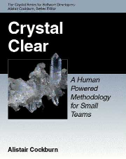
Crystal Clear : scope
E6
E10
For D6 projects:
3-6 people, close or in same room
Loss of discretionary moneys
(may extend to: E8 project)
Not for large projects
(insufficient group coordination)
Not for life-critical projects
(insufficient verification)
(Described in Crystal Clear, Cockburn, 2002
also in Agile Software Development, Cockburn 2001)
D6
D10
C6
C10

Slide 50
Crystal Clear : roles & teams
Must have: sponsor, senior designer, designer/programmer, user (part-time)
Combined roles: coordinator, business expert, requirements gatherer
Teams: single team of designers/programmers
Seating: single big room, or adjacent offices

Slide 51
Crystal Clear : Products and Milestones
Products
  Release sequence, Schedule of user viewings, deliveries
  Actors-goals list & Annotated use cases
  Design sketches & notes as needed, screen drafts
  Common object model
  Running code, Migration code, Test cases
  User manual
Publish: each
Review: each
  Methodology (pre- and mid-increment)
Declare:
  Requirements stable enough to design to,
  UI stable enough to document to,
  Application correct enough to deliver.

Slide 52
Crystal Clear : standards
Policy:
  Delivery increments every 2 + 1 months
  Tracking by milestones, not by work products
  Requirements in annotated usage scenarios (use cases)
  Mandatory regression testing of application function
  Peer code reviews
  Direct user involvement
  Ownership model for work products
Local standards (up to the team):
  Coding style
  UI style
  Regression test framework

Slide 53
Crystal Clear : tolerance
Policy standards are mandatory, but equivalent substitution are permitted (e.g. "Scrum")
Full tolerance on techniques: any technique allowed
Quite wide tolerance on work products
  Many alternatives to intermediate products accepted
  e.g., paper, whiteboard, online notes
  Low precision in early stages
  High precision only required for production work products
Assess the Quality of the communications, not the quality of the work products (except Test Cases).

Slide 54
What is Crystal?

Slide 55
Crystal is a set of rules for constructing an agile methodology . . .
. . . specific to your project
. . . adapting to your project
. . . within the project timeline.
http://alistair.cockburn.us/crystal

